Slide 1
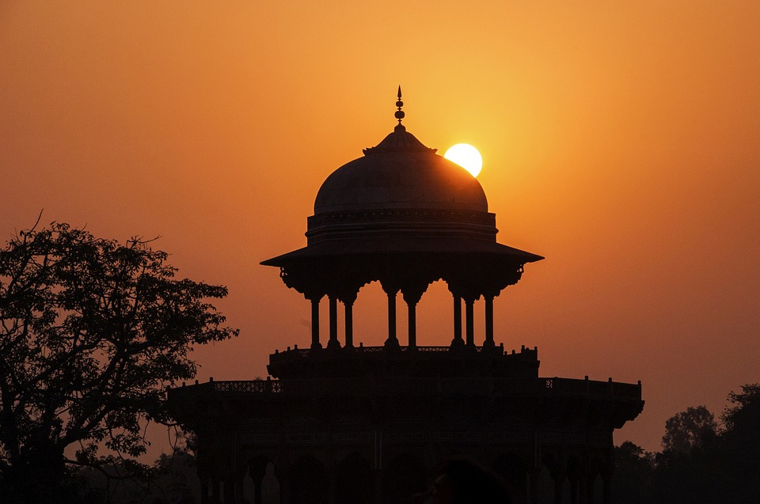
-------------
INDIA
India, land of vibrant colors and rich culture,
Where ancient traditions meet modern innovation's lure.
From the Himalayas' majesty to the oceans' azure,
In every corner, a tale of resilience and allure.

Slide 2
-------------
INDIA
India, land of vibrant colors and rich culture,
Where ancient traditions meet modern innovation's lure.
From the Himalayas' majesty to the oceans' azure,
In every corner, a tale of resilience and allure.

Slide 3
-------------
INDIA
India, land of vibrant colors and rich culture,
Where ancient traditions meet modern innovation's lure.
From the Himalayas' majesty to the oceans' azure,
In every corner, a tale of resilience and allure.

Slide 4
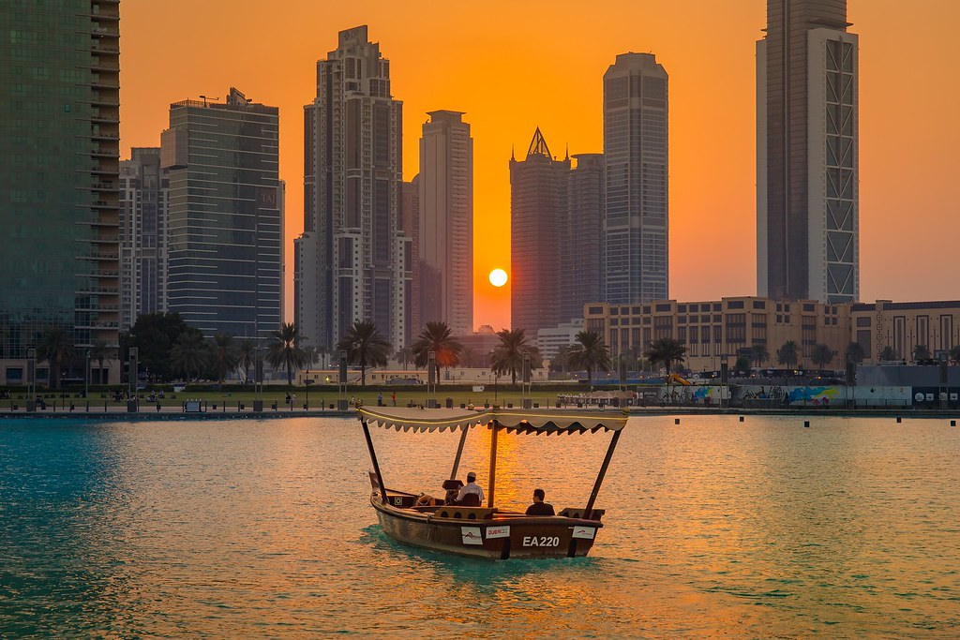
-------------
DUBAI
India, land of vibrant colors and rich culture,
Where ancient traditions meet modern innovation's lure.
From the Himalayas' majesty to the oceans' azure,
In every corner, a tale of resilience and allure.

Slide 5
-------------
DUBAI
India, land of vibrant colors and rich culture,
Where ancient traditions meet modern innovation's lure.
From the Himalayas' majesty to the oceans' azure,
In every corner, a tale of resilience and allure.

Slide 6
-------------
DUBAI
India, land of vibrant colors and rich culture,
Where ancient traditions meet modern innovation's lure.
From the Himalayas' majesty to the oceans' azure,
In every corner, a tale of resilience and allure.

Slide 7

-------------
CHINA
India, land of vibrant colors and rich culture,
Where ancient traditions meet modern innovation's lure.
From the Himalayas' majesty to the oceans' azure,
In every corner, a tale of resilience and allure.

Slide 8
-------------
CHINA
India, land of vibrant colors and rich culture,
Where ancient traditions meet modern innovation's lure.
From the Himalayas' majesty to the oceans' azure,
In every corner, a tale of resilience and allure.

Slide 9
-------------
CHINA
India, land of vibrant colors and rich culture,
Where ancient traditions meet modern innovation's lure.
From the Himalayas' majesty to the oceans' azure,
In every corner, a tale of resilience and allure.

